Slide 1


Boosting Circular Systemic Solutions through Virtual Regional Circular Economy Spaces for water-smart circular regions and cities
Rimini, Italy
George ARAMPATZIS | Technical University of Crete

Slide 2

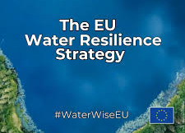
Securing a global strategically resource
Water
Energy
Transportation
Food Security
Industrial Capacity
Climate Adaptation
protect the water cycle
adopting water-smart practices
and green infrastructure
Notes:
WATER AS A STRATEGIC RESOURCE AND SECTOR IN EUROPE
The European Commission has formally recognised water as a strategic resource together with energy and transport, fundamentally impacting food security, industrial capacity, and climate adaptation across the continent.
The EU WRS was adopted by the European Commission on 4 June 2025, aiming to protect the water cycle by adopting water-smart practices and green infrastructure

Slide 3

Circularity as a norm in WRS
in a Water-Smart Economy
“…water and resource loops are largely closed to foster a circular economy…."
“…circularity becomes the norm…."
5 Key Enablers to support paradigm shift:
Robust Governance and Implementation
Finance and Investment in Infrastructure
Digitalisation and AI
Research and Innovation
Security and Preparedness
Notes:
CIRCULARILTY IN WATER RESILIENCE STRATEGY
The Water Resilience Strategy explicitly states that in a Water-Smart Economy, "water and resource loops are largely closed to foster a circular economy" and "circularity becomes the norm".
This paradigm shift is supported by five key enablers, including robust governance, strategic investments, and, critically, the acceleration of digitalisation and innovation.
The consensus among European policymakers is clear: Europe's future competitiveness is inevitably linked to its water resilience.

Slide 4

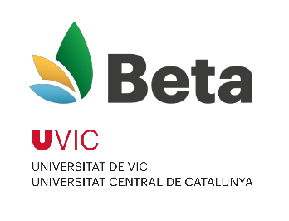




























CSSBoost – Project Consortium & Info
8 Universities & Research Centres
6
3
6
2
6 Large Companies & SMEs
21 partners
3.5 years
11,876,438€
1
1
1
7 Regions, Networks & pilot partners
1

Slide 5




The CSSBoost – Cyber-Physical Framework for Implementing the European Water Resilience Strategy
Digital
Social
Green
Circular Systemic Solutions (CSS):
Multi-actor, multi-value-chain model around shared circular objectives
The Triple Transition Gap
CCRI: Circular Cities and Regions Initiative
Notes:
Circular economy initiatives frequently remain small-scale, isolated, and disconnected from broader regional ecosystems, despite numerous local successes. Persistent systemic barriers, such as a critical lack of shared data and analytical tools, weak or isolated governance structures, and limited cooperation among essential actors, impede progress. This fragmentation hinders the full realisation of the economic and environmental potential of solutions and their scaling.
The foundational element of the project is the development and implementation of Circular Systemic Solutions (CSS). A CSS is defined not as a single technology or product, but as a multi-actor, multi-value-chain model that formally links businesses, public authorities, research institutions, and citizens around shared circular objectives. CSSBoost belongs in CCRI Initiave, Circular Cities and Regions, an innovative collaboration and support scheme of the European Commission, launched by DG Research & Innovation, part of CEAP 2020
The CSSBoost project was designed to directly address the “triple transition gap," which is a situation in which the digital, green and social transitions must advance in combination to overcome the obstacles that hinder regions from achieving a genuinely circular future.

Slide 6
The CSSBoost Project
Core Innovations
Alignment with CCRI
CSSBoost Application Framework
CSS Booster – Cyber-Physical System
CSSBoost Integrated Solution
Holistic framework handling a CSS as composite living entity
Open space of city/region/multi-region including CE market, value chains and entire external environment
Integration of CSS within digital environment
a) Vertical b)Horizontal
Notes:
1. Integration of one or more CSS within a digital environment, enhanced by tailored methodologies and procedures
2. VCEM – The Digital Heath of CSSBoost
3. Vertical Integration: Integration of each individual CSS into the CSSBoost physical and digital environment
Horizontal Integration: Integration of new and existing CSSs, CE value chains, resources, and stakeholders into a holistic regional cyber-physical system (VCEM)

Slide 7
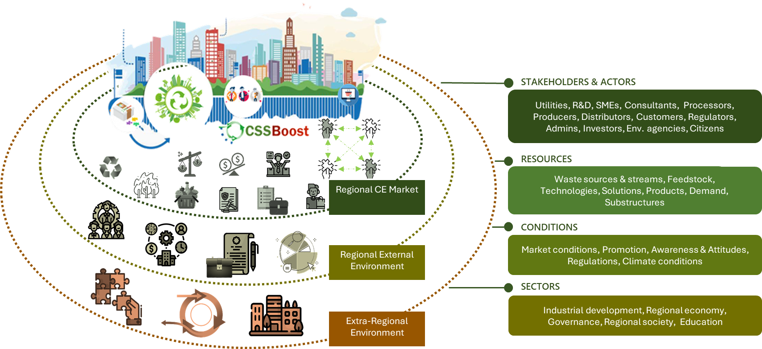
The CSSBoost Project
The Enabling Integrated Environment
CSS Booster
CSS Ecosystem and Market
Open (physical) space of city, regional or multi-regional scope based on an ecosystem approach
  CE Market (Resources, Stakeholders, Actors,…)
  Internal Environment (Conditions, Regulations,…)
  External Environment (Extra-regional CE Markets)
Virtualisation
  Dynamic monitoring
  Digital Twining
Information Sharing Platform
  Visualising
  Understanding
  Supporting
Cyber-Physical System
Alignment with the CCRI

Slide 8

CSS Booster as a Replicable Model for EU Water Resilience
Circular Value Chains
Create multi-actor, multi-value chains solutions addressing interconnected challenges simultaneously
Digital Platform and Life-Cycle Services
DT-based platform to provide governance & optimisation infrastructure for a Water-Smart Economy and management
Social Innovation Approach
Framework to include a co-creation and active stakeholders’ involvement empowering the social acceptance of CE
Notes:
The CSSBoost project is more than just a gathering of tech solutions; it also provides a reliable, consistent, and replicable framework for putting the European Water Resilience Strategy into action at the very important regional level. It gives a direct and real answer to the strategic need for a Water-Smart Europe by showing how to go from separate attempts to circular systems that are integrated, data-driven, and socially embedded.
The CSSBoost model works best when its three main parts are put together. These parts work together to make a whole package for changing systems:
Systemic Solutions (CSS): The framework's main idea is to create and oversee multi-actor, multi-value-chain answers that deal with multiple related problems at the same time. This all-around method, which goes beyond the limits of single-point interventions, is shown by the Marche pilot's focus on making money from both wastewater (as reclaimed water) and sludge (as bio-fertilizer).
As a Cyber-Physical Engine (VCEM), the project's digital twin gives us the governing and optimisation tools we need for a modern, water-smart economy. It gets rid of confusion and disorganisation by using data to create clear information and team-based, forward-looking management. This makes it possible for all sectors to work together as required by the WRS.
Social Innovation Methodology: The framework includes a structured method for co-creation and stakeholder involvement because it knows that technology alone isn't the answer. This makes sure that the circular economy plan will have the social acceptance, institutional buy-in, and behavioural change that it needs to work in the real world and last for a long time.

Slide 9
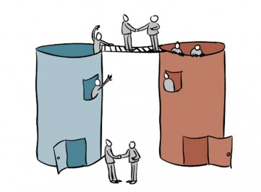

Impact on Water Resilience Strategy
"Accelerating digitalisation and AI"
CSSBoost provides a comprehensive digital governance framework for implementing a Water – Smart Economy regionally
…operates as an integrated predictive system…
The CSS Booster…
…that transforms the management of regional resources from silos-approach into a single, integrated system
Notes:
This cyber-physical framework aligns directly with the European Water Resilience Strategy's key enabler of "accelerating digitalisation and AI".
The CSSBoost project does not just apply digital tools to an existing problem; it provides a comprehensive digital governance framework for implementing a Water-Smart Economy at a regional scale.
The main outcome, the CSS Booster is more than a monitoring tool; it is a governance technology. It transforms the management of regional resources from a series of disconnected, reactive decisions made in silos into a single, integrated, and predictive system.
This repository of knowledge (meaning the CSS Booster) creates the necessary conditions for the "cross-sectoral collaboration" and "inclusive governance" that the WRS identifies as fundamental elements to build water resilience. This represents a fundamental shift in how circular economies can be governed, moving from policy ambition to data-driven operational reality.

Slide 10

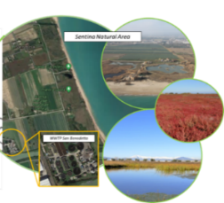
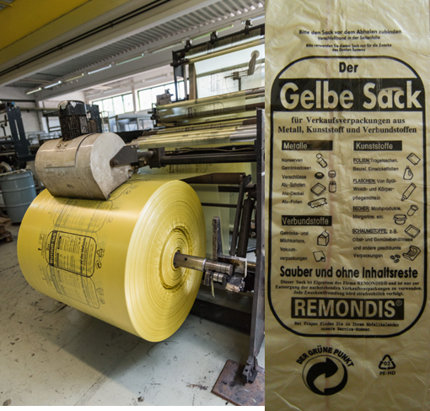
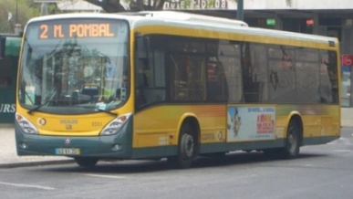
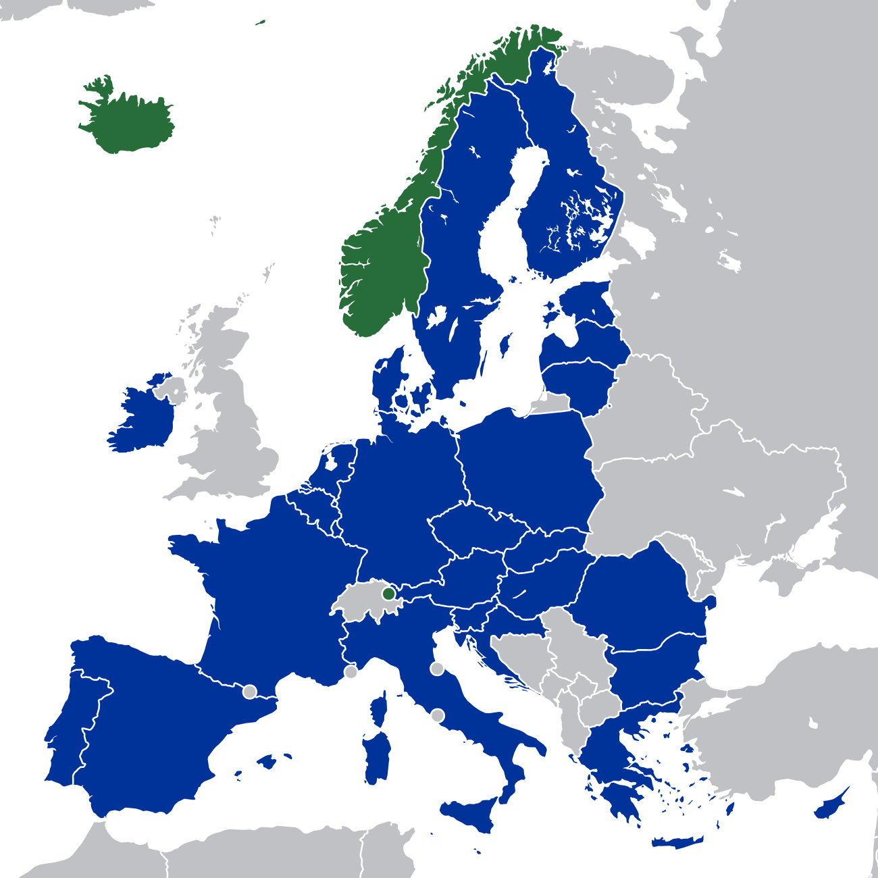
Realising Circular Systemic Solutions across Europe
Region of Crete, Greece | Agricultural, Livestock and Food Processing By-Products Valorization CSS in Crete, Greece
Region of Marche, Italy | Water Reuse and Nutrients Recovery CSS in Marche, Italy
Region of North Black Forest, Germany | Conventional Plastics and Bioplastics Recycling CSS in Nordschwarzwald, Germany
Region of Lisbon, Portugal | Public Transport Vehicles Recycling and Valorisation CSS in Lisbon, Portugal
Interregional, EU | Multi-Regional, Multinational CSS

Slide 11
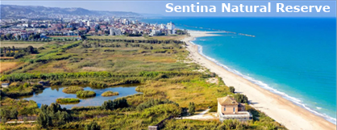
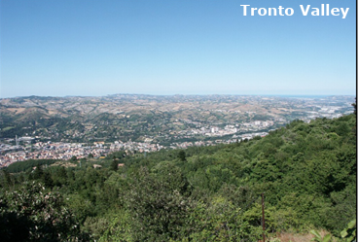
Realising the impact on Water Resilience Strategy through the Marche Region Blueprint
Addressing the regional challenges:
Significant water stress especially during summer in San Benedetto del Tronto peri-urban area
Fragile ecosystem – Sentina Natural Reserve – that is threaten from water scarcity
Viability of local agricultural economy
Currently no wastewater reuse performed in Marche Region
CSSBoost water-resilience intervention is an integrated CSS composed by two interconnected value chains:
Value Chain 1- Water Reuse for Ecosystem and Agricultural Resilience
Value Chain 2 - Nutrient Recovery for a Circular Bioeconomy
Notes:
The pilot in the Marche region of Italy, focused on "Water Reuse and Nutrients Recovery," serves as a powerful, concrete demonstration of how the CSSBoost model translates theory into practice, providing a replicable blueprint for implementing the European Water Resilience Strategy in water-stressed territories.
The pilot addresses a severe and multifaceted challenge.
The peri-urban area of San Benedetto del Tronto in the Marche region experiences significant water stress, particularly during summer months.
This scarcity directly threatens the fragile ecosystem of the Sentina Natural Reserve—a protected wetland of high ecological value—and puts in danger the viability of the local agricultural economy. This issue is further complicated by a severe institutional reality: the Marche Region currently lacks any wastewater reuse, resulting in the complete loss of a valuable potential resource. This establishes a distinct and urgent baseline against which the project's impact can be measured.
CSSBoost water-resilience intervention is an integrated CSS composed by two interconnected value chains:
Value Chain 1- Water Reuse for Ecosystem and Agricultural Resilience. This value chain is all about turning the waste water from the San Benedetto Wastewater Treatment Plant (WWTP) into a new, non-traditional water source. Nature-Based Solutions (NBS) are a big part of this answer and make it work. To provide improved, low-energy refinement of the treated wastewater, a demonstration plant is being built. It includes a pre-filtration unit and both horizontal and vertical constructed wetlands. The high-quality recycled water that is made will do two important things: it will provide a stable source of water for irrigation in agriculture, and it will also fill up the natural ponds in the Sentina Reserve, which will directly protect this important ecosystem from the effects of drought.
Value Chain 2 - Nutrient Recovery for a Circular Bioeconomy. This value chain deals with sewage sludge, which is a "waste" stream from the WWTP, as well as other organic wastes from dairy, aquaculture, and food industries in the area. These leftovers are turned into useful materials by using high-tech methods like anaerobic co-digestion and pilot-scale thermochemical treatments. These methods get nutrients like nitrogen and phosphorus back into the materials. The final product is a steady and safe biofertilizer that can be used in local farming. This cuts down on the need for synthetic fertilisers made from fossil fuels that are imported and stops the nutrient pollution that usually happens when sludge is thrown away in the usual way.

Slide 12
Realising the impact on Water Resilience Strategy through the Marche Region Blueprint
CSSBoost Marche Pilot Action/Technology | Concrete Impact & Added Value | EU Water Resilience Strategy Objective Supported
NBS (Constructed Wetlands) for Wastewater Refinement | A new, resilient water source, mitigating drought impact and providing water security for local agriculture. | Restoring and Protecting the Water Cycle. Promoting NBS as a primary tool for enhancing water retention and reducing risks.
Nutrient Recovery from Sludge & Organic Waste | Transform waste into valuable bio-fertilisers, closing the nutrient loop. Reducing the need for synthetic fertilizers, preventing nutrient pollution of water bodies, lowering agriculture carbon footprint, enhancing regional resource autonomy. | Building a Water-Smart Economy. Closing resource loops, fostering a circular economy, and applying the "Water Efficiency First" principle across sectors.
Virtualisation (Digital Twining) for System Monitoring & Optimisation | Data-driven platform for all stakeholders to manage water-nutrient nexus, predictive management to improve efficiency & resilience the resource flows. Overcoming governance fragmentation. | Accelerating Digitalisation & AI. Fostering innovative, cross-sectoral governance and implementation through data-driven collaboration.
Notes:
NBS (Constructed Wetlands) for Wastewater Refinement: Makes a new, strong, non-traditional water source that will directly help the Sentina Natural Reserve deal with drought and give local farms water security. Shows a low-energy model that can be used again in an area where wastewater has never been reused before, turning a problem into a strategic asset.
Nutrient Recovery from Sludge & Organic Waste: Closes the nutrition loop by turning waste into biofertilizers that plants can use. This cuts down on the need for manmade fertilisers, which keeps nutrients from polluting nearby waterways. It also lowers agriculture's carbon footprint and makes it easier for regions to manage their own resources.
CSSBooster Digital Twin for System Monitoring & Optimisation: Offers a data-driven platform for all stakeholders (utility, farmers, reserve managers) to control the water-nutrient nexus, allowing predictive management to improve efficiency and resilience and make resource flows more efficient. This gets rid of fragmentation in government.
Conclusion: The CSSBoost test project in Marche is more than just a green project. It shows how a Water-Smart Economy works in a small way. It shows how a systemic, digitally-enabled approach can improve the health of the environment, make the agricultural sector more economically stable, and create new circular value chains. This can be used as a model by other European areas that want to follow it.

Slide 13
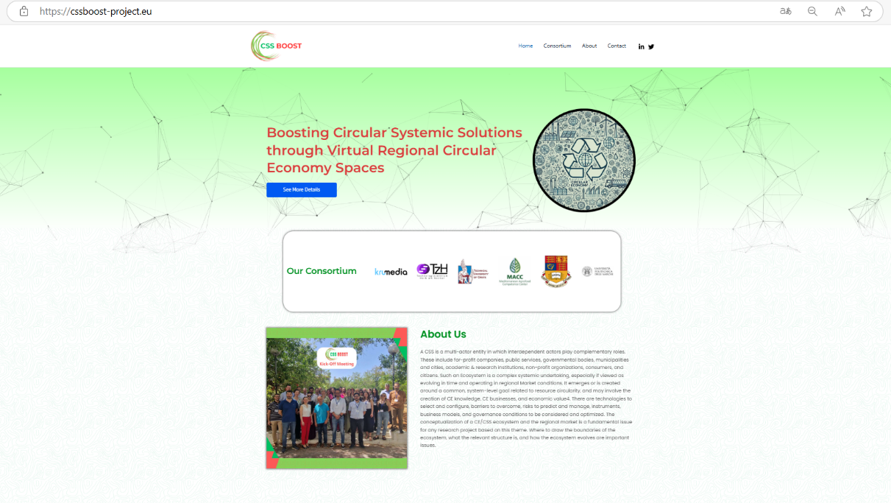



Website and Social Media Channels
CSSBoost
@Css-BoostProject
Visit Our Project Website : cssboost-project.eu

Slide 14

Thank You!
George Arampatzis | Indigo – TUC
Associate Professor, School of Production Engineering & Management, Technical University of Crete
garampatzis@tuc.gr

