Slide 1



Boosting Circular Systemic Solutions through Virtual Regional Circular Economy Space
Project Overview and Water Reuse & Nutrient Recovery CSS
Rimini | 05/10/2024
George Arampatzis

Slide 2
Introduction

Slide 3




CSSBoost At a Glance
Boosting Circular Systemic Solutions through Virtual Regional Circular Economy Spaces
Topic CL6-2023-CircBio-02-1 – Circular Cities and Regions Initiative (CCRI)’s circular systemic solutions
Destination Circular economy and bioeconomy sectors
Coordinated by Technical University of Crete, Assoc. Prof. George Arampatzis
€
21 Partners
8 Countries
5 Pilot Case
11,876,438€
9,190,319€ EC
3.5 years
Started June 2024

Slide 4
Consortium
No | Participant Organisation Name | Type | Short | Country
1 | Polytechneio Kritis (Technical University of Crete) | UNI | TUC | Greece
2 | Maggioli Spa | LE | MAG | Italy
3 | CAS Software AG | LE | CAS | Germany
4 | Krumedia GmbH | SME | KRUM | Germany
5 | Technologiezentrum Horb GmbH & Co. KG | NET | TZHORB | Germany
6 | Bwcon Research gGmbH | RI | BWCON | Germany
7 | Wirtschaftsforderung Zukunftsregio GmbH | REG | WFG | Germany
8 | Universita Politecnica Delle Mache | UNI | UNIVPM | Italy
9 | Cicli Integrati Impianti Primari S.p.A. | LE | CIIP | Italy
10 | Fundació Universitària Balmes | UNI | UVIC | Spain
11 | Elliniko Mesogriako Panepistimio (Hellenic Mediterranean University) | UNI | HMU | Greece
12 | Mediterranean Agrofood Competence Center | NET | MACC | Greece
13 | Perifereiakh Anaptyxiakh Etaireia Krhths (Regional Development Company of Crete) | REG | CRETE | Greece
14 | Particle Summary | SME | PARTICLE | Portugal
15 | Companhia Carris de Ferro de Lisboa, E.M., S.A. | LE | CARRIS | Portugal
16 | Adrestia Research and Development Private Company | SME | ADR | Greece
17 | Motonious P.C. | SME | MOTON | Greece
18 | Acceligence LTD | SME | ACCELI | Cyprus
19 | Social CRM Research Center e.V. | RI | SCRC | Germany
20 | Association of Cities and Regions for sustainable Resource Management | NET | ACR+ | Belgium
21 | Imperial College London (Associate Partner) | UNI | ICL | UK

Slide 5
CCRI

Slide 6

About the Circular Cities and Regions Initiative
An innovative collaboration and support scheme of the European Commission, launched by DG Research & Innovation
Part of the EU Circular Economy Action Plan 2020, and contributing to the policy objectives of the EU Green Deal as well as the EU Bioeconomy Strategy
Supported by the EU's R&I funding programme (Horizon 2020 and Horizon Europe): more than €250 million earmarked for CCRI
Aims to support the implementation of Circular Systemic Solutions (CSS) in EU cities and regions, as well as the development of new circular business and governance models

Slide 7








What the CCRI is about?
Identifying drivers & barriers to territorial innovation
Encouraging on-the-ground experimentation, supporting pilots and demonstrations
Highlighting promising (replicable) solutions, suggesting practical steps forward, preparing for full-scale territorial deployment
►► Structuring and maturing cities’ circular projects to a stage where they become scalable, bankable and therefore, truly impactful
- Innovation Continuum -
Piloting &
demonstrating
Idea
generation
Replication &
upscaling

Slide 8
The Need

Slide 9
CSSBoost Challenges and Motivation
The needs to boost and accelerate CE transition
Sustain non-replaceable natural resources
Climate change
Promote lifestyle change towards resource conservation
The status
“There is only limited evidence that the CE action plans had influenced circular-economy activities in the member states” (The European Council of Auditors, 2023)
The main reason
Circular business models usually take place on a micro-level (an individual firm)
Not accounting the systemic implementation of CE principles that often span across firms and other stakeholders in a city or region or groups
The solution
The Circular Systemic Solution (CSS) concept (Projects applying innovative circular models involving different actors, value-chains, levels of government & governance)
The barriers
Small-scale solutions are more applicable and controllable
Large-scale solutions are vulnerable to systemic barriers and organisational and governance inefficiencies of CE
CSSs are susceptible to changes in social and economic conditions
Need to Accelerate CE transition by Boosting Circular Systemic Solutions in Cities, Regions or their Groupings

Slide 10
Strategic CSSBoost Objectives
Maximise the adoption and impact of any CSS, by applying it within an enabling integrated environment
Extend this environment to energise and manage the entire CE transition in cities and regions
Maximise CSS sustainability and growth along its entire lifecycle
Enable knowledge exchange, CE relations and interoperability between different regions/cities
Target the advancement of CE in specific EU regions and promote CE methods and mind-set

Slide 11
The Concepts and the Solution

Slide 12



















CE/CSS Ecosystem and Market
STAKEHOLDERS & ACTORS
Utilities, R&D, SMEs, Consultants, Processors, Producers, Distributors, Customers, Regulators, Administrators, Investors, Env. agencies, Citizens
Utilities, R&D, SMEs, Consultants, Processors, Producers, Distributors, Customers, Regulators, Admins, Investors, Env. agencies, Citizens
RESOURCES
Waste sources & streams, Feedstock,
Technologies, Solutions, Products, Demand, Substructures
Waste sources & streams, Feedstock,
Technologies, Solutions, Products, Demand, Substructures
Regional CE Market
CONDITIONS
Market conditions, Promotion, Awareness & Attitudes, Regulations, Climate conditions
Regional External Environment
Market conditions, Promotion, Awareness & Attitudes, Regulations, Climate conditions
SECTORS
Industrial development, Regional economy, Governance, Regional society, Education
Industrial development, Regional economy, Governance, Regional society, Education
Extra-Regional Environment

Slide 13












The Enabling Integrated Environment
CSS Booster
Application Framework
Open (physical) space of city, regional or multi-regional scope based on an ecosystem approach
CE Market
Internal Environment
External Environment
Virtualisation
Dynamic monitoring
Digital Twining
Information Sharing Platform
Visualising
Understanding
Supporting
Cognitive
Digital Twin
Application Planning
Data Acquisition & Data Spaces
VCEM
Open Circularity
EcoSphere
Information Sharing Platform
CSSBoost Integrated Solution
AI and BD Analytics
Social Innovation
Actions
Cyber-Physical System
Regional CE/CSS
Ecosystem
and Market
CSS Stakeholders’
Support Services
Business Plans
CSS Life Cycle
Management Services
Financing Plans

Slide 14
EU Strategic Pillars relevant to CSSBoost
Digitalisation
Ecosystem Approach
Business Models
Financial Strategies
Circular Economy Market
Triple Transition

Slide 15
The Offerings

Slide 16
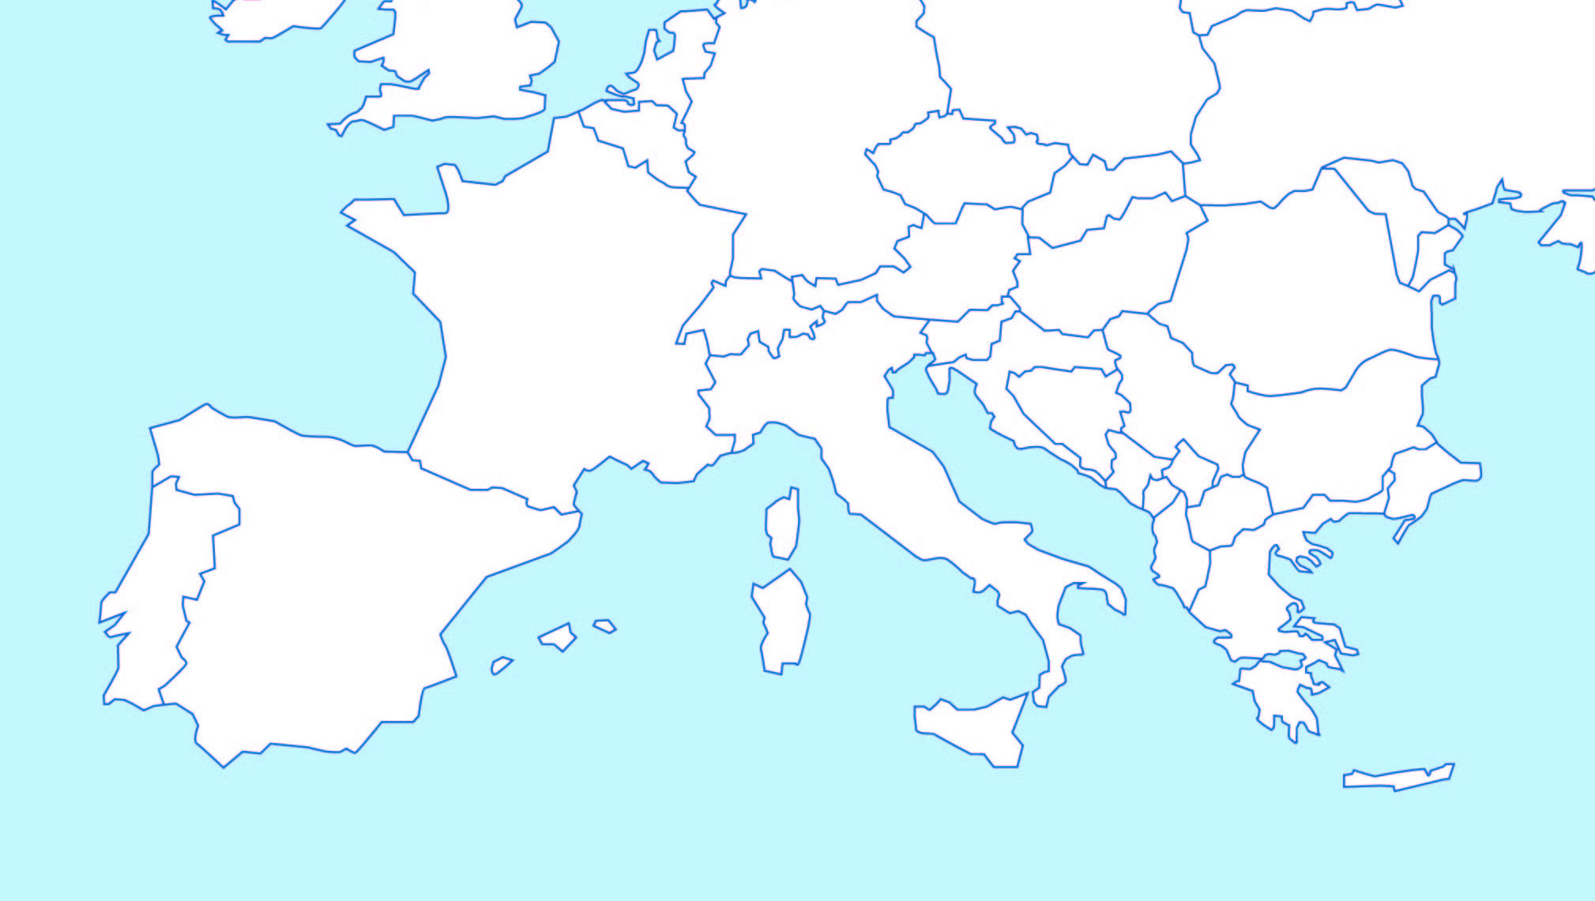
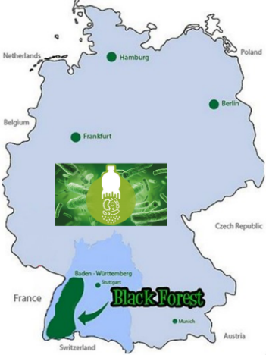
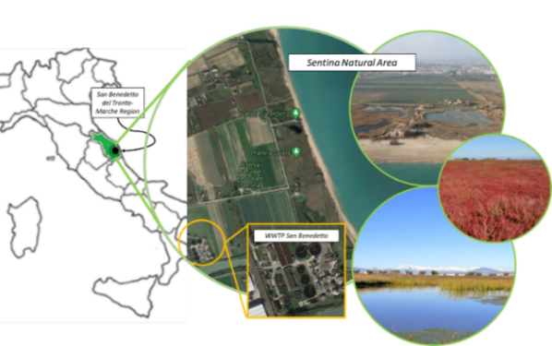
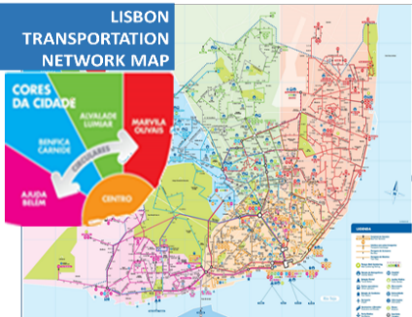

Pilot Circular Systemic Solutions
CSS 3 – North Black Forest, Germany
CSS 2 – Marche, Italy
CSS 4 – Lisbon, Portugal
CSS 1 – Crete, Greece
CSS 5 – Interregional, Multi-National

Slide 17
Demonstrators
No | Region | Scope / Sectors | Partners | Value Chains
1 | Crete, Greece | Agricultural, Livestock and Food Processing By-Products Valorisation CSS | MACC, CRETE, HMU, TUC | Fertilizer and materials for soil improvement produced using biomass from livestock production New types of plant bio-stimulants More nutritious (low glycemic index) versions of bread and other bakery products
2 | Marche, Italy | Water Reuse and Nutrients Recovery CSS | UNIVPM, UVIC, CIIP | Water for irrigation and nature restoration Nutrients for agriculture
3 | North Black Forest, Germany | Conventional Plastics and Bioplastics Recycling CSS | CAS, MAG, TZHORB, WFG, BWCOM, KRUM | Conventional plastics Bioplastics
4 | Lisbon, Portugal | Public Transport Vehicle Recycling and Valorisation CSS | PARTICLE, CARRIS, MOTON | Use of recyclable materials from public transport vehicles Material recovery at vehicle end-of-life disposal
5 |  | Multi-regional Multi-National Value Chain CSS | UVIC, All Pilots leaders | All above

Slide 18
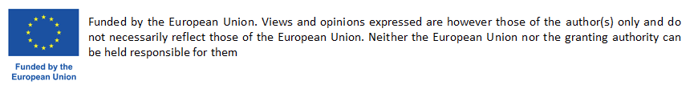
Thank You!
NAMES

