Slide 1

Social Innovation for and acceptance of circular systemic solutions
EU Green Week 2025(Online) | 23 June 2025
George ARAMPATZIS | Technical University of Crete (TUC)

Slide 2




CSSBoost At a Glance
Boosting Circular Systemic Solutions through Virtual Regional Circular Economy Spaces
Topic CL6-2023-CircBio-02-1 – Circular Cities and Regions Initiative (CCRI)’s circular systemic solutions
Destination Circular economy and bioeconomy sectors
Coordinated by Technical University of Crete, Assoc. Prof. George Arampatzis
€
21 Partners
8 Countries
5 Pilot Cases
11,876,438€ 9,190,319€ EU
3.5 years
Started June 2024
Notes:
CSSBoost is a recently started Innovation Action project, funded under the Horizon Europe Framework Programme, and supporting the strategic objectives of the Circular Cities and Regions Initiative (CCRI). CCRI is a European Commission's initiative, under the European Circular Economy Action Plan, aiming to accelerate the transition to a circular economy in cities and regions across Europe.

Slide 3





























Project Consortium
8 Universities & Research Centres
6
3
6
2
6 Large Companies & SMEs
1
1
1
7 Regions, Networks & pilot partners
1

Slide 4

The Circular Shift: Powering EU’s Regenerative Transformation
…a Europe not defined by limits, but by endless possibilities…
…a continent where 'waste' becomes 'resource’, fueling innovation, resilient economies and communities…
…moving beyond theory, this future is generated through
Circular Systemic Solutions (CSS)…
…and initiatives like the Circular Cities and Regions Initiative (CCRI) are catalysts in this journey
Notes:
Imagine a Europe not defined by limits, but by endless possibilities. A continent where 'waste' becomes 'resource,' fueling innovation, resilient economies and communities. This is the transformative power of the Circular Economy.
We are moving beyond theory, actively building this future through pioneering Circular Systemic Solutions (CSS) – holistic approaches that redesign our systems from the ground up for sustainability and regeneration.
Initiatives like the Circular Cities and Regions Initiative (CCRI) are crucial catalysts in this journey, uniting diverse actors and empowering regions to accelerate this vital transformation.

Slide 5

The CSSBoost Vision
Boosting Circular Systemic Solutions through Virtual Regional Circular Economy Spaces
The Challenge
Need for sustainable resource use
The Barriers
Technological, economic, social, governance
The goal
Boost the transition of regions to Circular Economy and Bioeconomy
The project
Maximise adoption & impact of CSSs, overcoming barriers & risks, by applying it within an enabling integrated environment
Notes:
A main reason behind slow progress in circular economy transition is the fact that circular business models usually take place on a micro-level (an individual firm) and are thus limited in their ability to realize the systemic nature of circular economy principles that often span across firms and other stakeholders in a city or region or cluster of cities and regions.
It is also important to realize that any circular solution as a dynamic and transformable entity in a changing environment. It must be expanded, gain momentum, create new value chain, influence and be influenced by the circular economy market and find extra-regional markets; face completion, risks and threats
The circular systemic solution concept, if correctly and extensively applied, points to the right direction. However, the full deployment of circular systems in cities and regions still needs to be unlocked. Small-scale solutions are more easily applicable and controllable, but large-scale systemic solutions are vulnerable to systemic barriers, changes in economic conditions and problems arising from the social dimension of circular economy which are not so easily managed.
It is a need to attract from the very beginning and keep in time the interest and activation of a sufficiently large number of commercial companies, consultants, investors, regulators, local and regional authorities and others, so as to gain sufficient momentum.
CSSBoost provides a supportive (enabling) environment, equipped with advanced processes and innovative digital tools, so as to provide an interesting experience and powerful tools to participants that would attract their attention.

Slide 6
Triple Transition of Cities and Regions
Circular Economy
Decarbonisation
Natural resources preservation
Real time monitoring
Virtualisation
Life cycle optimisation
Just transition
Social equity and inclusion
Education and skills
Notes:
CSSBoost applies the concept of triple transition (green, digital and social) to realize circular systemic solutions (CSS), a strategic concept of the CCRI. CSSs are projects applying innovative circular models involving different actors, different value-chains with synergies and different levels of governance in cities, regions or cluster of regions.
The transitions towards a greener and more digital future are reshaping our world across various domains. Green policy strategies are focusing on circular economy, renewable energy, conservation, biodiversity protection, and climate change mitigation and adaptation. The digital transition, involves the current rapid advancements in technology, the digitalisation and automation, with a leading role artificial intelligence (AI).
As these transitions gain momentum, it is crucial to acknowledge that current social dynamics show an increase of global inequalities and political instability, rising poverty rates, declining human development, a worsening of labour conditions, and greater food and energy insecurity. These social risks, expose the need for development strategies that consider the interlinkages between the green, digital and social dimensions. In other words, the current issues can only be solved through systemic transformative change.
A Triple Transition Agenda therefore brings an opportunity for creating new growth models that put people and the planet first. It takes account not just of the consequences of the digital and green transitions on current social structures, but also of the role of social dynamics in shaping the success of development paths for economic productivity and environmental sustainability.

Slide 7
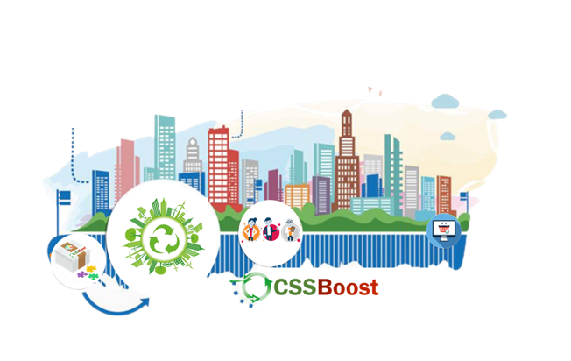


















CE/CSS Ecosystem and Market
STAKEHOLDERS & ACTORS
Utilities, R&D, SMEs, Consultants, Processors, Producers, Distributors, Customers, Regulators, Administrators, Investors, Env. agencies, Citizens
Utilities, R&D, SMEs, Consultants, Processors, Producers, Distributors, Customers, Regulators, Admins, Investors, Env. agencies, Citizens
RESOURCES
Waste sources & streams, Feedstock,
Technologies, Solutions, Products, Demand, Substructures
Waste sources & streams, Feedstock,
Technologies, Solutions, Products, Demand, Substructures
Regional CE Market
CONDITIONS
Market conditions, Promotion, Awareness & Attitudes, Regulations, Climate conditions
Regional External Environment
Market conditions, Promotion, Awareness & Attitudes, Regulations, Climate conditions
SECTORS
Industrial development, Regional economy, Governance, Regional society, Education
Industrial development, Regional economy, Governance, Regional society, Education
Extra-Regional Environment
Notes:
CSSBoost considers the city or the region as an open space (an ecosystem), involving the existing circular economy market, its value chains with the technologies and actors and its entire external environment. This complex physical system is virtualized, monitored, analyzed and controlled by developing and applying novel digital solutions.

Slide 8












The Enabling Integrated Environment
CSS Booster
Open (physical) space of city, regional or multi-regional scope based on an ecosystem approach
CE Market
Internal Environment
External Environment
Virtualisation
Dynamic monitoring
Digital Twining
Information Sharing Platform
Visualising
Understanding
Supporting
Application Framework
Cognitive
Digital Twin
Application Planning
Data Acquisition & Data Spaces
Virtual Regional CE Space
Open Circularity
EcoSphere
Information Sharing Platform
CSSBoost Integrated Solution
AI and BD Analytics
Social Innovation
Actions
Cyber-Physical System
Regional CE/CSS
Ecosystem
and Market
CSS Stakeholders’
Support Services
Business Plans
CSS Life Cycle
Management Services
Financing Plans
Notes:
The CSS Booster (the main CSSBoost Enabling Environment) is a novel type of area-wide multi-level Cyber-Physical System
It is reralised through the virtualisation and support of the physical component, the ecosystem and market.
It dynamically monitors and assesses at any time the status of the physical system, enabling (a) the optimum CSS implementation overcoming barriers; (b) supporting CSS lifecycle management (c) provide support to key actors

Slide 9
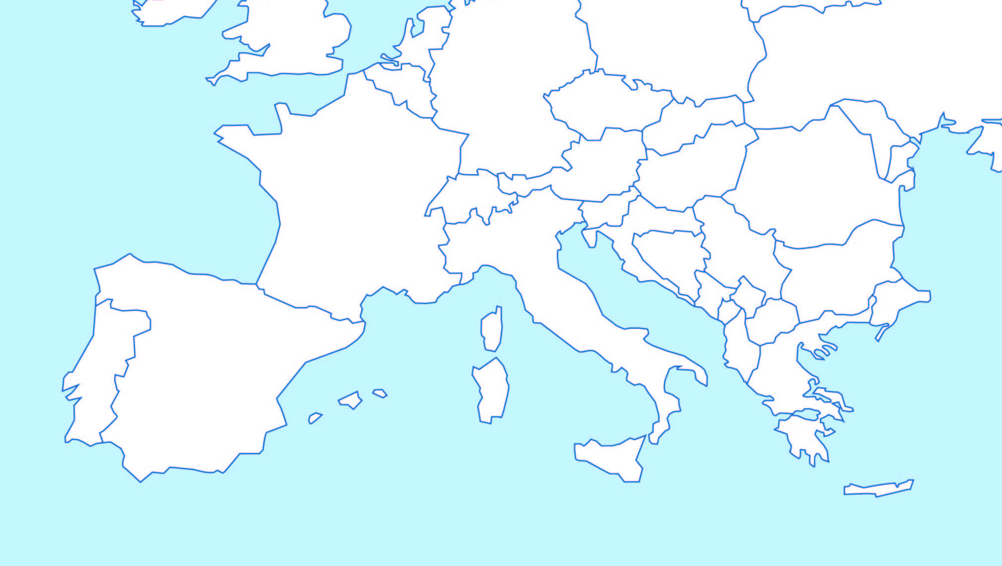
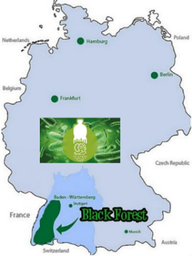
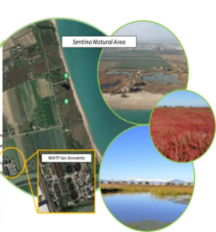
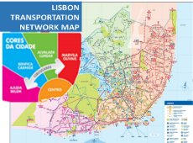

Pilot Areas
Pilot 3 – North Black Forest, Germany
Conventional Plastics and Bioplastics Recycling CSS
Pilot 4 – Lisbon, Portugal Public Transport Vehicle Recycling and Valorisation CSS
Pilot 2 – Marche, Italy Water Reuse and Nutrients Recovery CSS
Pilot 1 – Crete, Greece Agricultural, Livestock and Food Processing By-Products Valorisation CSS
Pilot 5 – Multi-regional Multi-National Value Chain CSS

Slide 10
Pilot #1 – Region of Crete, GR
Agricultural, Livestock and Food Processing By-Products Valorisation
3 Value Chains
Fertiliser and materials for soil improvement produced using biomass from livestock production
New types of plant bio-stimulants
More nutritious (low glycemic index) versions of bread and other bakery products
4 Partners
MACC CRETE, HMU, TUC

Slide 11


Pilot #2 – Region of Marche, IT
Water Reuse and Nutrients Recovery CSS
2 Value Chains
Water for irrigation and nature restoration
Nutrients for agriculture
3 Partners
UNIVPM, UVIC, CIIP

Slide 12

Pilot #3 – North Black Forest, DE
Conventional Plastics & Bioplastics Recycling CSS
2 Value Chains
Supporting a plastics-oriented value chain
Establishing a digital product passport for eco-friendly products
6 Partners
CAS, MAG, TZHORB, WFG, BWCOM, KRUM

Slide 13
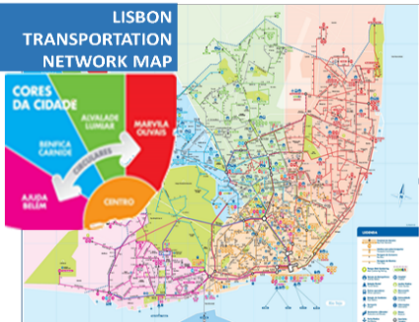
Pilot #4 – Region of Lisbon, PT
Public Transport Vehicle Recycling and Valorisation CSS
2 Value Chains
Use of recyclable materials from public transport vehicles
Material recovery at vehicle end-of-life disposal
3 Partners
PARTICLE, CARRIS, MOTON

Slide 14
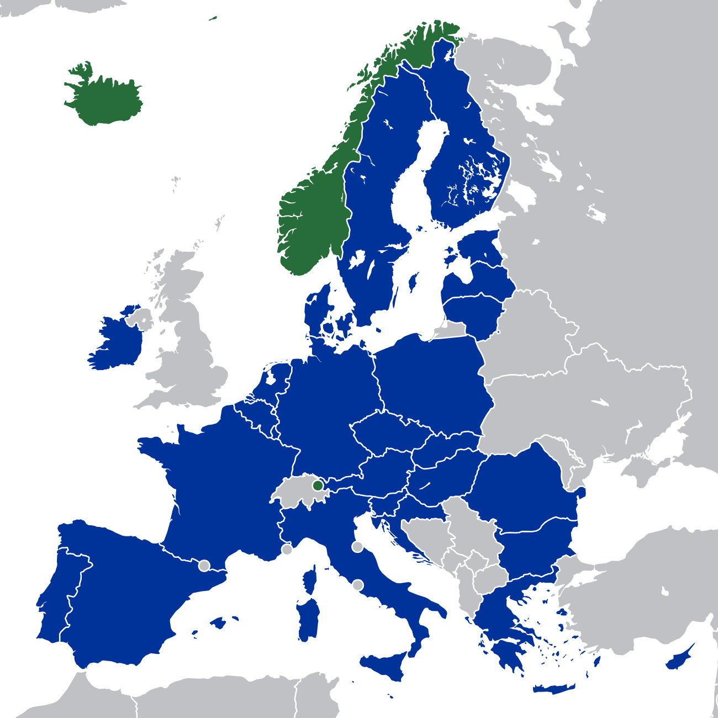
Pilot #5 – Interregional, EU
Interregional Multi-National Value Chain CSS
1-4 In Concert Value Chains
Vehicles and batteries,
Agriculture/agro-food/livestock,
Wastewater, and,
Plastics/bioplastics
5 Partners
UVIC + 4 Pilot Leaders: GR, IT, DE, PT

Slide 15
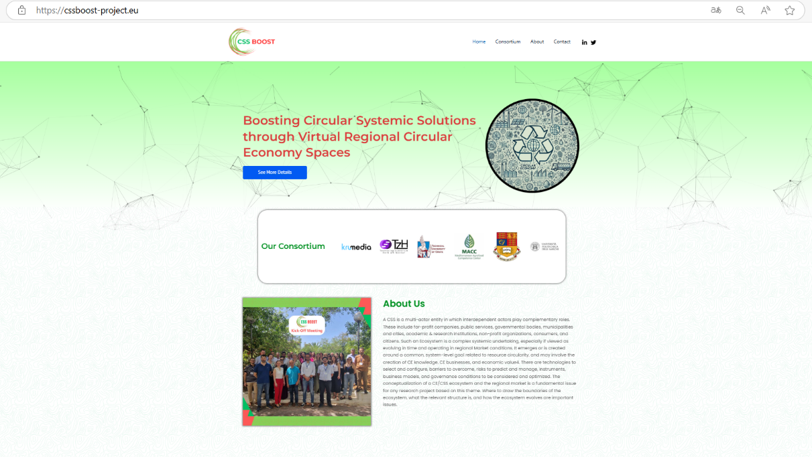



Website and Social Media Channels
CSSBoost
@Css-BoostProject
Visit Our Project Website : cssboost-project.eu

Slide 16

Thank You!
George ARAMPATZIS | indigo – TUC
garampatzis@tuc.gr

