Slide 1

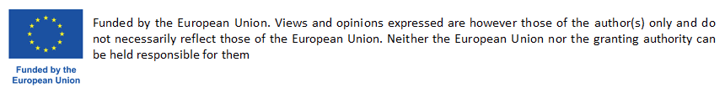
Boosting Circular Systemic Solutions through Virtual Regional Circular Economy Space
Project Overview
CCRI – SISTERS PROJECTS CLUSTERING EVENT
Online Event|10/07/2024
Assoc. Prof. George Arampatzis | Technical University of Crete (TUC)

Slide 2
Introduction

Slide 3




CSSBoost At a Glance
Boosting Circular Systemic Solutions through
Virtual Regional Circular Economy Spaces
Topic CL6-2023-CircBio-02-1 – Circular Cities and Regions Initiative (CCRI)’s circular systemic solutions
Destination Circular economy and bioeconomy sectors
Coordinated by Technical University of Crete, Assoc. Prof. George Arampatzis
€
21 Partners
8 Countries
5 Pilot Case
11,876,438€
9,190,319€ EC
3.5 years
Started June 2024

Slide 4
Consortium
No | Participant Organisation Name | Type | Short | Country
1 | Polytechneio Kritis (Technical University of Crete) | UNI | TUC | Greece
2 | Maggioli Spa | LE | MAG | Italy
3 | CAS Software AG | LE | CAS | Germany
4 | Krumedia GmbH | SME | KRUM | Germany
5 | Technologiezentrum Horb GmbH & Co. KG | NET | TZHORB | Germany
6 | Bwcon Research gGmbH | RI | BWCON | Germany
7 | Wirtschaftsforderung Zukunftsregio GmbH | REG | WFG | Germany
8 | Universita Politecnica Delle Mache | UNI | UNIVPM | Italy
9 | Cicli Integrati Impianti Primari S.p.A. | LE | CIIP | Italy
10 | Fundació Universitària Balmes | UNI | UVIC | Spain
11 | Elliniko Mesogriako Panepistimio (Hellenic Mediterranean University) | UNI | HMU | Greece
12 | Mediterranean Agrofood Competence Center | NET | MACC | Greece
13 | Perifereiakh Anaptyxiakh Etaireia Krhths (Regional Development Company of Crete) | REG | CRETE | Greece
14 | Particle Summary | SME | PARTICLE | Portugal
15 | Companhia Carris de Ferro de Lisboa, E.M., S.A. | LE | CARRIS | Portugal
16 | Adrestia Research and Development Private Company | SME | ADR | Greece
17 | Motonious P.C. | SME | MOTON | Greece
18 | Acceligence LTD | SME | ACCELI | Cyprus
19 | Social CRM Research Center e.V. | RI | SCRC | Germany
20 | Association of Cities and Regions for sustainable Resource Management | NET | ACR+ | Belgium
21 | Imperial College London (Associate Partner) | UNI | ICL | UK

Slide 5
The Need

Slide 6
Challenges and Motivation
The needs to boost and accelerate CE transition
  Sustain non-replaceable natural resources
  Climate change
  Promote lifestyle change towards resource conservation
The status
  “There is only limited evidence that the CE action plans had influenced circular-economy activities in the member states” (The European Council of Auditors, 2023)
The main reason
  Circular business models usually take place on a micro-level (an individual firm)
  Not accounting the systemic implementation of CE principles that often span across firms and other stakeholders in a city or region or groups
The solution
  The Circular Systemic Solution (CSS) concept (Projects applying innovative circular models involving different actors, value-chains, levels of government & governance)
The barriers
  Small-scale solutions are more applicable and controllable
  Large-scale solutions are vulnerable to systemic barriers and organisational and governance inefficiencies of CE
  CSSs are susceptible to changes in social and economic conditions
Need to Accelerate CE transition
by Boosting Circular Systemic Solutions in Cities, Regions or their Groupings

Slide 7
Strategic CSSBoost Objectives
Maximise the adoption and impact of any CSS, by applying it within an enabling integrated environment
Extend this environment to energise and manage the entire CE transition in cities and regions
Maximise CSS sustainability and growth along its entire lifecycle
Enable knowledge exchange, CE relations and interoperability between different regions/cities
Target the advancement of CE in specific EU regions and promote CE methods and mind-set

Slide 8
EU Strategic Pillars relevant to CSSBoost
Digitalisation
Ecosystem Approach
Business Models
Financial Strategies
Circular Economy Market
Triple Transition

Slide 9
The Concepts and the Solution

Slide 10



















CE/CSS Ecosystem and Market
STAKEHOLDERS & ACTORS
Utilities, R&D, SMEs, Consultants, Processors, Producers, Distributors, Customers, Regulators, Administrators, Investors, Env. agencies, Citizens
Utilities, R&D, SMEs, Consultants, Processors, Producers, Distributors, Customers, Regulators, Admins, Investors, Env. agencies, Citizens
RESOURCES
Waste sources & streams, Feedstock,
Technologies, Solutions, Products, Demand, Substructures
Waste sources & streams, Feedstock,
Technologies, Solutions, Products, Demand, Substructures
Regional CE Market
CONDITIONS
Market conditions, Promotion, Awareness & Attitudes, Regulations, Climate conditions
Regional External Environment
Market conditions, Promotion, Awareness & Attitudes, Regulations, Climate conditions
SECTORS
Industrial development, Regional economy, Governance, Regional society, Education
Industrial development, Regional economy, Governance, Regional society, Education
Extra-Regional Environment

Slide 11












The Enabling Integrated Environment
CSS Booster
Application Framework
Open (physical) space of city, regional or multi-regional scope based on an ecosystem approach
  CE Market
  Internal Environment
  External Environment
Virtualisation
  Dynamic monitoring
  Digital Twining
Information Sharing Platform
  Visualising
  Understanding
  Supporting
Cognitive
Digital Twin
Application Planning
Data Acquisition & Data Spaces
VCEM
Open Circularity
EcoSphere
Information Sharing Platform
CSSBoost Integrated Solution
AI and BD Analytics
Social Innovation
Actions
Cyber-Physical System
Regional CE/CSS
Ecosystem
and Market
CSS Stakeholders’
Support Services
Business Plans
CSS Life Cycle
Management Services
Financing Plans

Slide 12







Lifecycle of CSSBoost Solution
Exploration
Application Planning
CONSOLIDATION
ADAPTATION UPGRADING
Resources & Players Mapping; Background knowledge; Data Reporting; PESTLE & SWOT; Market analysis
Value chain Monitoring; Dynamic Assessment; Process Optimisation; Supply-Demand balancing
Technology selection; Implementation plan; Business, Financing, Governance plan
Business initiatives; SH’s' activation; Adaptation plans; Technologies upgrade
S1
S3
S5
S7
S2
S4
S6
FEASIBILITY APPROVAL
IMPLEMENTATION
EXPANSION
UPSCALING
Feasibility, Sustainability, Economics, Critical Factors analysis
Operational Plan; Clustering, Training and Activation of SHs; Promotion plan
CE Market monitoring; CE Potential assess; Opportunities assess;
Interregional communed

Slide 13
Implementation

Slide 14
Work Plan
WP1 provides project coordination and management
WP2 develops the Application Framework and designs the CSSs
WP3 develops the modules/services to manage the lifecycle management of CSS and to support CE stakeholders
WP4 develops the cognitive digital system, employing data acquisition, knowledge engineering, DT and AI technologies
WP5 demonstrates the CSSBoost solutions in pilot areas
WP6 produces plans for their market uptake and exploitation
WP7 provides dissemination, communication, training and social innovation activities
WP2 – CSSBoost Application Framework and Design of Solutions for the Pilot Cases
Development
WP3 – CSS Lifecycle Management and Regional CE Stakeholders Decision Support Services
WP1 – Project Management
WP5 – Solution Integration, Demonstration and Evaluation in Pilot Cases
Integration
WP7 – Outreach Activities for Impact Maximisation
WP4 – CE/CSS Ecosystem Virtualisation and CSSBoost Digital Platform Development
WP6 – Sustainability, Upscaling, Replication and Business Planning

Slide 15
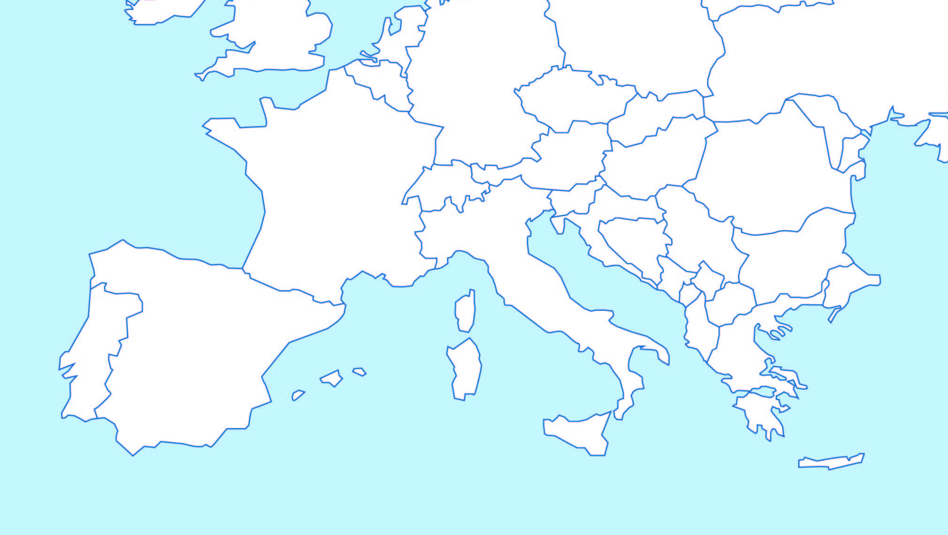
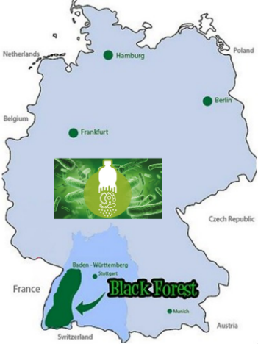
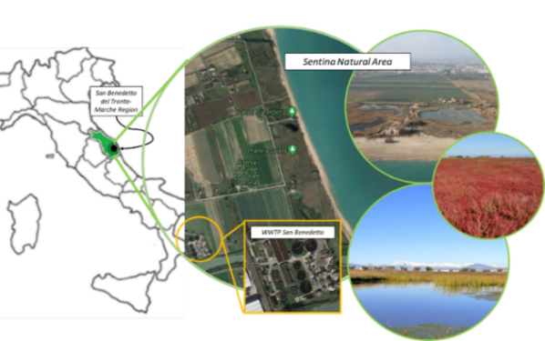
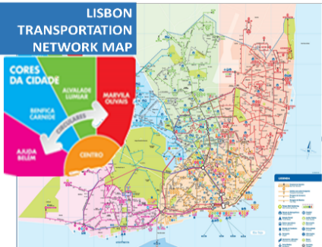

Pilot Cases
Pilot 3 – North Black Forest, Germany
Pilot 2 – Marche, Italy
Pilot 4 – Lisbon, Portugal
Pilot 1 – Crete, Greece
Pilot 5 – Interregional, Multi-National

Slide 16
Demonstrators
No | Region | Scope / Sectors | Partners | Value Chains
1 | Crete, Greece | Agricultural, Livestock and Food Processing By-Products Valorisation CSS | MACC, CRETE, HMU, TUC | Fertilizer and materials for soil improvement produced using biomass from livestock production New types of plant bio-stimulants More nutritious (low glycemic index) versions of bread and other bakery products
2 | Marche, Italy | Water Reuse and Nutrients Recovery CSS | UNIVPM, UVIC, CIIP | Water for irrigation and nature restoration Nutrients for agriculture
3 | North Black Forest, Germany | Conventional Plastics and Bioplastics Recycling CSS | CAS, MAG, TZHORB, WFG, BWCOM, KRUM | Conventional plastics Bioplastics
4 | Lisbon, Portugal | Public Transport Vehicle Recycling and Valorisation CSS | PARTICLE, CARRIS, MOTON | Use of recyclable materials from public transport vehicles Material recovery at vehicle end-of-life disposal
5 |  | Multi-regional Multi-National Value Chain CSS | UVIC, All Pilots leaders | All above

Slide 17
Thank You!
George Arampatzis
garampatzis@tuc.gr
Technical University of Crete

