Slide 1
Cluster of CSS Sister Projects
Kick-Off Meeting
30 Sep 2025
George Arampatzis| Technical University of Crete

Slide 2




CSSBoost At a Glance
Boosting Circular Systemic Solutions through
Virtual Regional Circular Economy Spaces
Topic CL6-2023-CircBio-02-1 – Circular Cities and Regions Initiative (CCRI)’s circular systemic solutions
Destination Circular economy and bioeconomy sectors
Coordinated by Technical University of Crete, Assoc. Prof. George Arampatzis
€
21 Partners
8 Countries
5 Pilot Cases
11,876,438€
9,190,319€ EU
3.5 years
Started June 2024

Slide 3
Consortium
No | Participant Organisation Name | Type | Short | Country
1 | Technical University of Crete (Coordinator) | UNI | TUC | Greece
2 | Maggioli Spa | LE | MAG | Italy
3 | CAS Software AG | LE | CAS | Germany
4 | Krumedia GmbH | SME | KRUM | Germany
5 | Technologiezentrum Horb GmbH & Co. KG | NET | TZHORB | Germany
6 | Bwcon Research gGmbH | RI | BWCON | Germany
7 | Wirtschaftsforderung Zukunftsregio GmbH | REG | WFG | Germany
8 | Universita Politecnica Delle Mache | UNI | UNIVPM | Italy
9 | Cicli Integrati Impianti Primari S.p.A. | LE | CIIP | Italy
10 | Fundació Universitària Balmes | UNI | UVIC | Spain
11 | Hellenic Mediterranean University | UNI | HMU | Greece
12 | Mediterranean Agrofood Competence Center | NET | MACC | Greece
13 | Regional Development Company of Crete | REG | CRETE | Greece
14 | Particle Summary | SME | PARTICLE | Portugal
15 | Companhia Carris de Ferro de Lisboa, E.M., S.A. | LE | CARRIS | Portugal
16 | Adrestia Research and Development Private Company | SME | ADR | Greece
17 | Motonious P.C. | SME | MOTON | Greece
18 | Acceligence LTD | SME | ACCELI | Cyprus
19 | Social CRM Research Center e.V. | RI | SCRC | Germany
20 | Association of Cities and Regions for sustainable Resource Management | NET | ACR+ | Belgium
21 | Imperial College London (Associate Partner) | UNI | ICL | UK

Slide 4
Strategic CSSBoost Objectives
Maximise the adoption and impact of any CSS, by applying it within an Enabling Integrated Environment
Extend this environment to energise and manage the entire CE transition in cities and regions
Maximise CSS sustainability and growth along its entire lifecycle
Enable knowledge exchange, CE relations and interoperability between different regions/cities
Target the advancement of CE in specific EU regions and promote CE methods and mind-set

Slide 5



















CE/CSS Ecosystem and Market
STAKEHOLDERS & ACTORS
Utilities, R&D, SMEs, Consultants, Processors, Producers, Distributors, Customers, Regulators, Administrators, Investors, Env. agencies, Citizens
Utilities, R&D, SMEs, Consultants, Processors, Producers, Distributors, Customers, Regulators, Admins, Investors, Env. agencies, Citizens
RESOURCES
Waste sources & streams, Feedstock,
Technologies, Solutions, Products, Demand, Substructures
Waste sources & streams, Feedstock,
Technologies, Solutions, Products, Demand, Substructures
Regional CE Market
CONDITIONS
Market conditions, Promotion, Awareness & Attitudes, Regulations, Climate conditions
Regional External Environment
Market conditions, Promotion, Awareness & Attitudes, Regulations, Climate conditions
SECTORS
Industrial development, Regional economy, Governance, Regional society, Education
Industrial development, Regional economy, Governance, Regional society, Education
Extra-Regional Environment
Notes:
A systemic approach considers the city or the region as an open space (an ecosystem), involving the existing circular economy market, its value chains with the technologies and actors and its entire external environment.

Slide 6
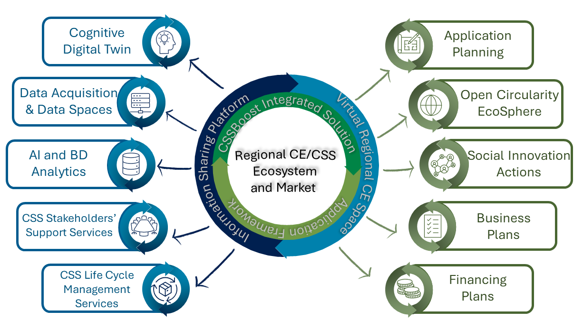
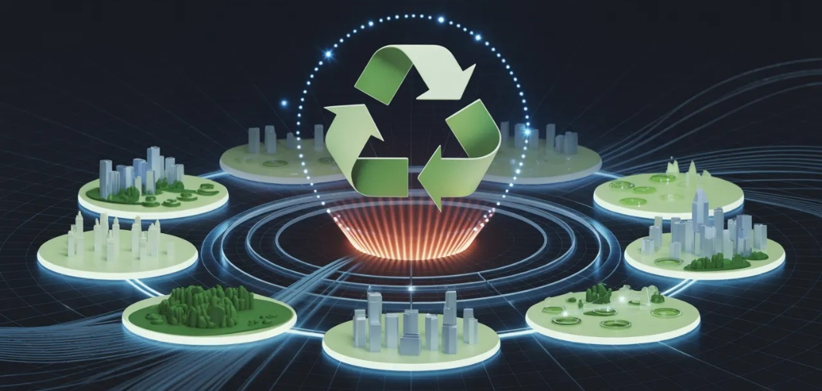
The Enabling Integrated Environment
CSS Booster (A Cyber-Physical System)
Open (physical) space of city, regional or multi-regional scope based on an ecosystem approach
Virtualization (Dynamic monitoring, Digital Twining)
Information Sharing Platform (Visualizing, Understanding, Supporting)
Notes:
The CSS Booster (the main CSSBoost Enabling Environment) is a novel type of area-wide multi-level Cyber-Physical System
It is reralised through the virtualisation and support of the physical component, the ecosystem and market.
It dynamically monitors and assesses at any time the status of the physical system, enabling (a) the optimum CSS implementation overcoming barriers; (b) supporting CSS lifecycle management (c) provide support to key actors

Slide 7
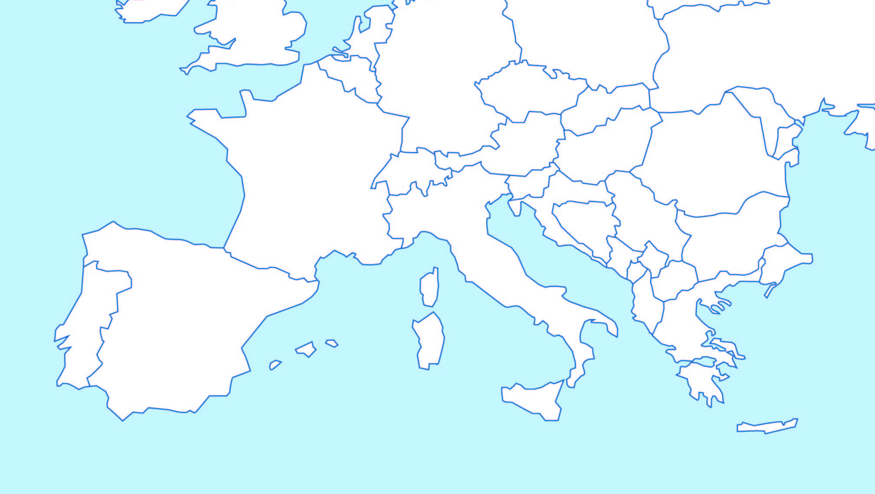
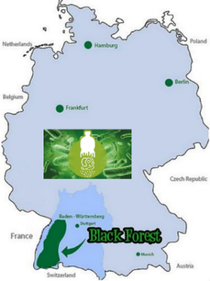
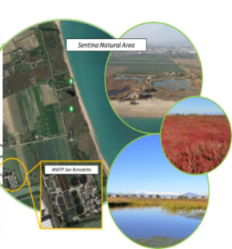
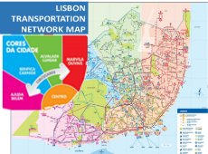

CSS Demonstration Areas
Pilot 3 – North Black Forest, Germany
Pilot 2 – Marche, Italy
Pilot 4 – Lisbon, Portugal
Pilot 1 – Crete, Greece
Pilot 5 – Interregional, Multi-National

Slide 8
CSS#1 – Region of Crete, EL
Agricultural, Livestock and Food Processing By-Products Valorisation
3 Value Chains
Fertiliser and materials for soil improvement produced using biomass from livestock production
New types of plant bio-stimulants
More nutritious (low glycemic index) versions of bread and other bakery products
4 Partners
MACC CRETE, HMU, TUC

Slide 9

CSS#2 – Region of Marche, IT
Water Reuse and Nutrients Recovery CSS
2 Value Chains
Water for irrigation and nature restoration
Nutrients for agriculture
3 Partners
UNIVPM, UVIC, CIIP

Slide 10

CSS #3 – North Black Forest, DE
Conventional Plastics & Bioplastics Recycling CSS
2 Value Chains
Supporting a plastics-oriented value chain
Establishing a digital product passport for eco-friendly products
6 Partners
CAS, MAG, TZHORB, WFG, BWCOM, KRUM

Slide 11
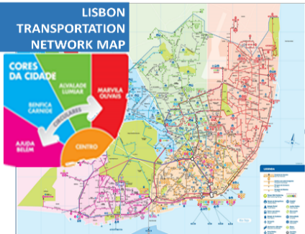
CSS #4 – Region of Lisbon, PT
Public Transport Vehicle Recycling and Valorisation CSS
2 Value Chains
Use of recyclable materials from public transport vehicles
Material recovery at vehicle end-of-life disposal
3 Partners
PARTICLE, CARRIS, MOTON

Slide 12
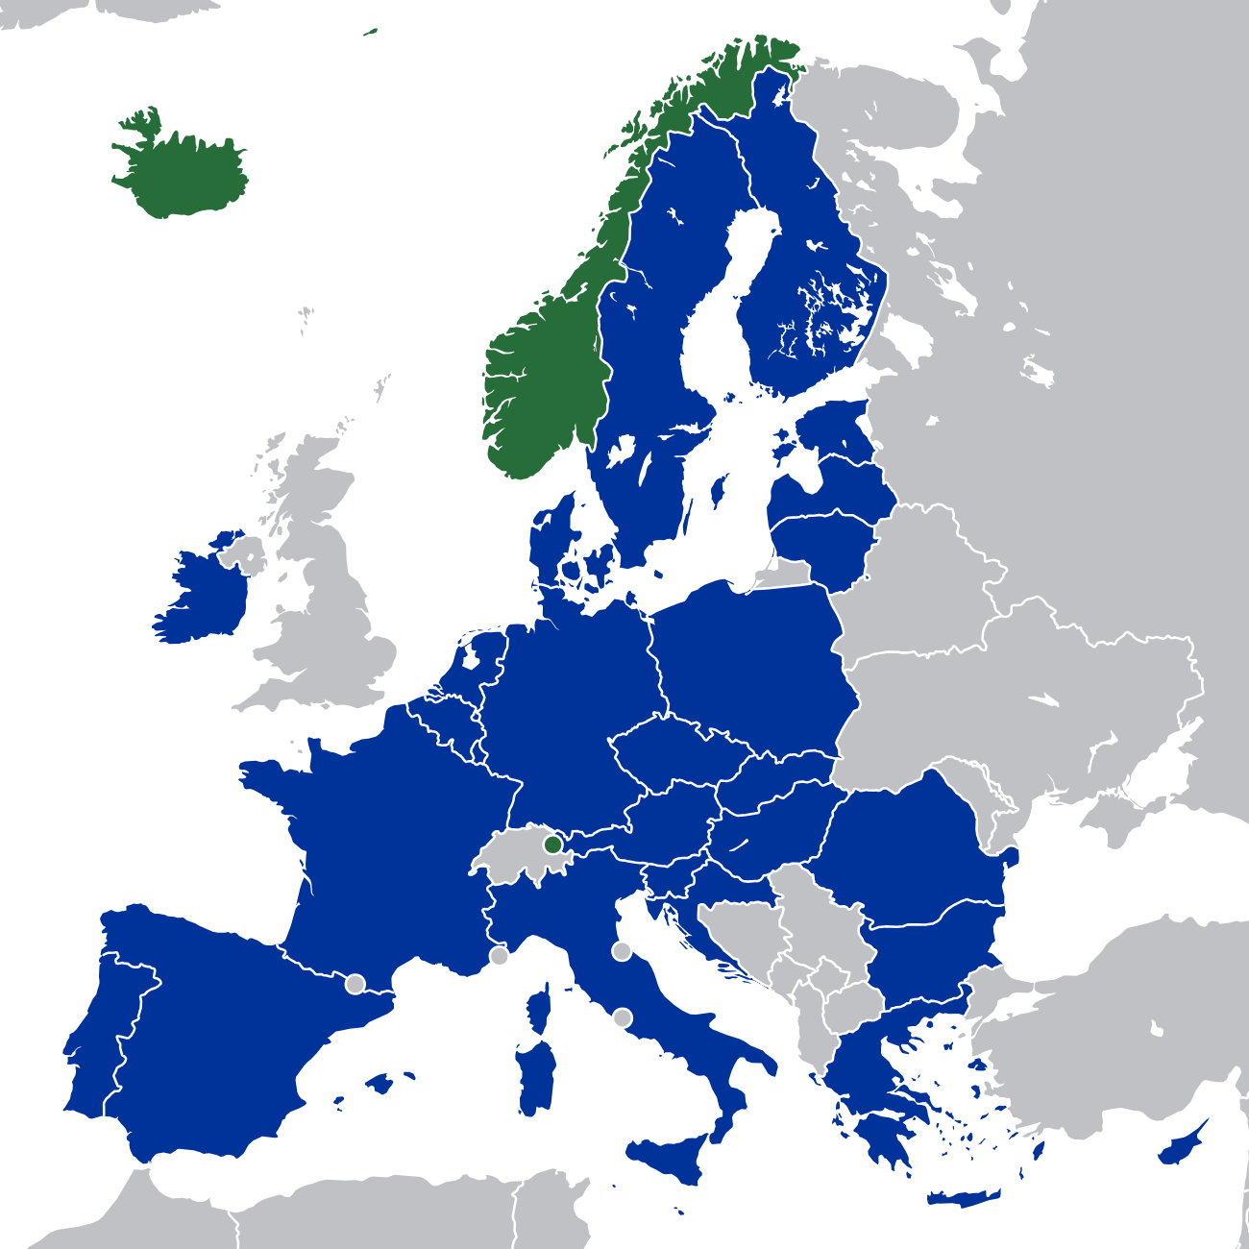
CSS#5 – Interregional, EU
Interregional Multi-National Value Chain CSS
1-4 In Concert Value Chains
Vehicles and batteries,
Agriculture/agro-food/livestock,
Wastewater, and,
Plastics/bioplastics
5 Partners
UVIC + 4 Pilot Leaders: GR, IT, DE, PT

Slide 13
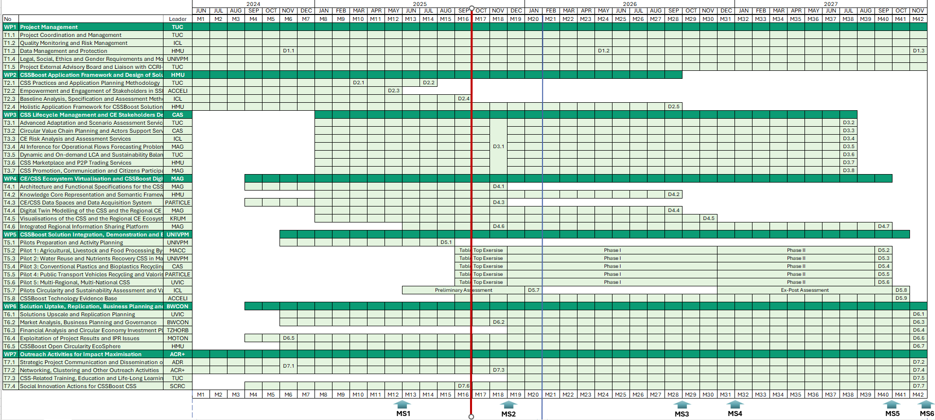
Work Plan
Knowledge Integration: CSSBoost Application Framework
1st Vertical Integration:
Start of pilot demonstration Phase 1

Slide 14
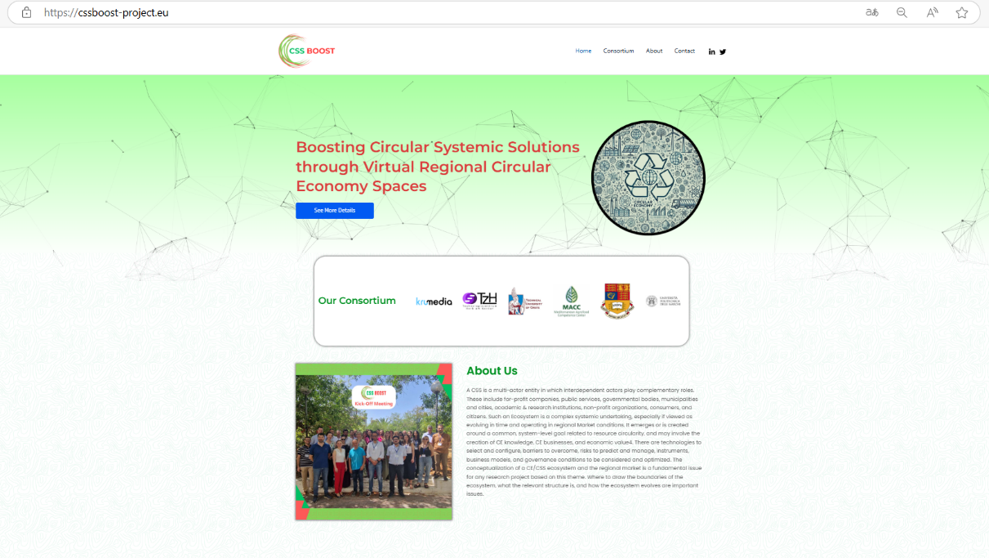



Website and Social Media Channels
CSSBoost
@Css-BoostProject
Visit Our Project Website : cssboost-project.eu

Slide 15
Thank You!

