Slide 1


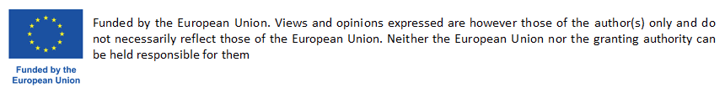
Boosting Circular Systemic Solutions through Virtual Regional Circular Economy Space
CCRI Workshop
From demonstration to deployment of circular solutions: First lessons learnt from CCRI pilot cases
Online Event | 16/01/2025
George ARAMPATZIS | Technical University of Crete (TUC)

Slide 2
CSSBoost Challenges and Objectives
CHALLENGES
The needs to boost and accelerate CE transition Sustain non-replaceable natural resources, Climate change, Promote lifestyle change towards resource conservation
The status “There is only limited evidence that the CE action plans had influenced CE activities in the member states” (The European Council of Auditors, 2023)
The main reason Circular business models take place on a micro-level (an individual firm) not accounting the systemic implementation
The solution The Circular Systemic Solution (CSS) concept (Projects applying innovative circular models involving different actors, value-chains, levels of government & governance)
BARRIERS FOR CSS APPLICATION
Vulnerable to systemic barriers and organisational and governance inefficiencies of CE
Susceptible to changes in social and economic conditions
CSSBoost OBJECTIVES
Maximise the adoption and impact of any CSS, by applying it within an enabling integrated environment
Extend this environment to energise and manage the entire CE transition in cities and regions
Maximise CSS sustainability and growth along its entire lifecycle
Enable knowledge exchange, CE relations and interoperability between different regions/cities
Target the advancement of CE in specific EU regions and promote CE methods and mind-set

Slide 3
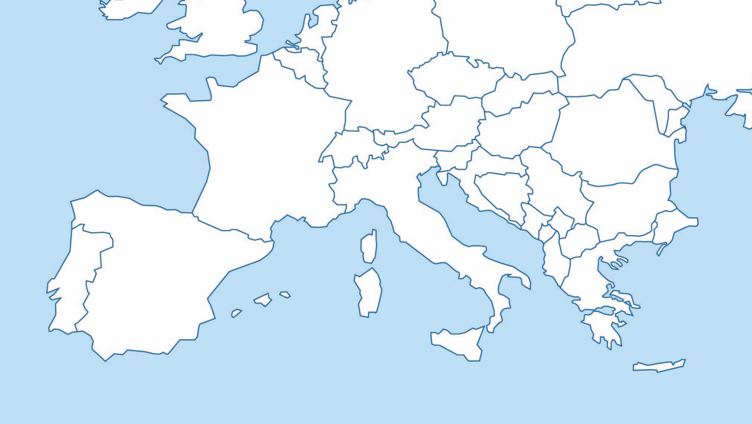
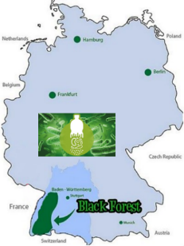
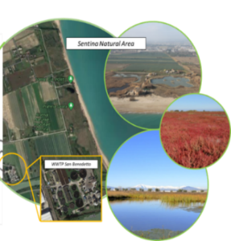
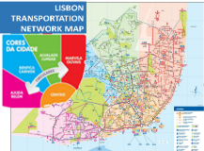
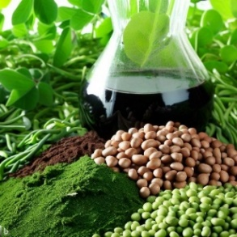
CSSBoost Pilot Circular Systemic Solutions
CSS 3 – North Black Forest, Germany
CSS 2 – Marche, Italy
CSS 4 – Lisbon, Portugal
CSS 1 – Crete, Greece
CSS 5 – Interregional, Multi-National

Slide 4
CSSBoost Demonstrators
No | Region | Scope / Sectors | Value Chains
1 | Crete, Greece | Agricultural, Livestock and Food Processing By-Products Valorisation CSS | Fertilizer and materials for soil improvement produced using biomass from livestock production New types of plant bio-stimulants More nutritious (low glycemic index) versions of bread and other bakery products
2 | Marche, Italy | Water Reuse and Nutrients Recovery CSS | Water for irrigation and nature restoration Nutrients for agriculture
3 | North Black Forest, Germany | Conventional Plastics and Bioplastics Recycling CSS | Conventional plastics Bioplastics
4 | Lisbon, Portugal | Public Transport Vehicle Recycling and Valorisation CSS | Use of recyclable materials from public transport vehicles Material recovery at vehicle end-of-life disposal
5 | All above | Multi-regional Multi-National Value Chain CSS | All above

Slide 5
Thank You!
George ARAMPATZIS
garampatzis@tuc.gr
Technical University of Crete

